Slide 1
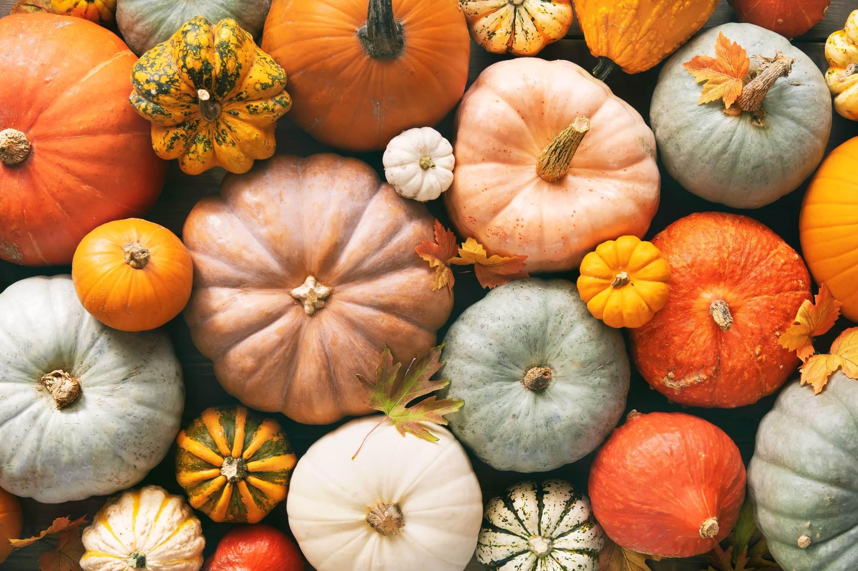




New Haw Community School
PTA Newsletter
Autumn 2025
The PTA is up and running and we’re excited for 2025! We hope you are looking forward to our planned inset day to LEGOLAND! This year we see the return of Break the Rules Day and Wonka bars. We have lots more fun initiatives up our sleeve for later this year so please keep your eyes peeled.
With many of last years members stepping down due to family and work commitments we have a new team! Saying goodbye and thank you to: Annette Damianoff, Christian Russell and Claire Rollo. Introducing the team of 2025: Kat Gooch & Nicky Payne will be stepping down as Co-Chairs but staying on board, taking their place as the new Chairperson is Jess Bailey and Vice Chair Lou Rowley , Andrea Prentis will be fulfilling the role as Treasurer, Amy Griffiths, Sonia Lemon, Crystal Davis,Eloise Costa Neves and Aimee Ponte are coming on board to support the rest of us! We’re always on the look-out for new members so if you would like to join our team then please speak to any member of the PTA or contact newhawjuniorpta@gmail.com Finally, there are events which we can’t run without parents help. Please look out for the Volunteer links that come round and sign up where you can – we really appreciate your support in providing your children with great experiences and ensuring that we raise as much money as possible for the school.
Donation Link
If you can’t get to our events, but would still like to contribute to the school then you can use the following link to make a donation at any point in the year: https://pay.sumup.com/b2c/QBQIQ5BR
STAY IN THE LOOP
Join our Facebook group (New Haw Community School Parents) and follow us on Instagram (New_Haw_Community_School_PTA)

Slide 2

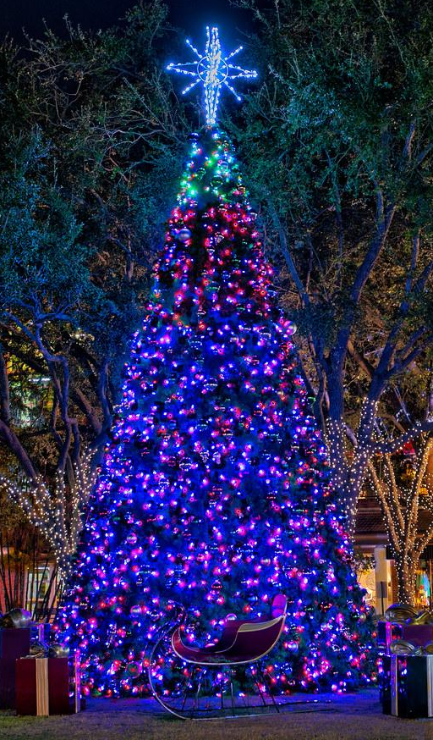
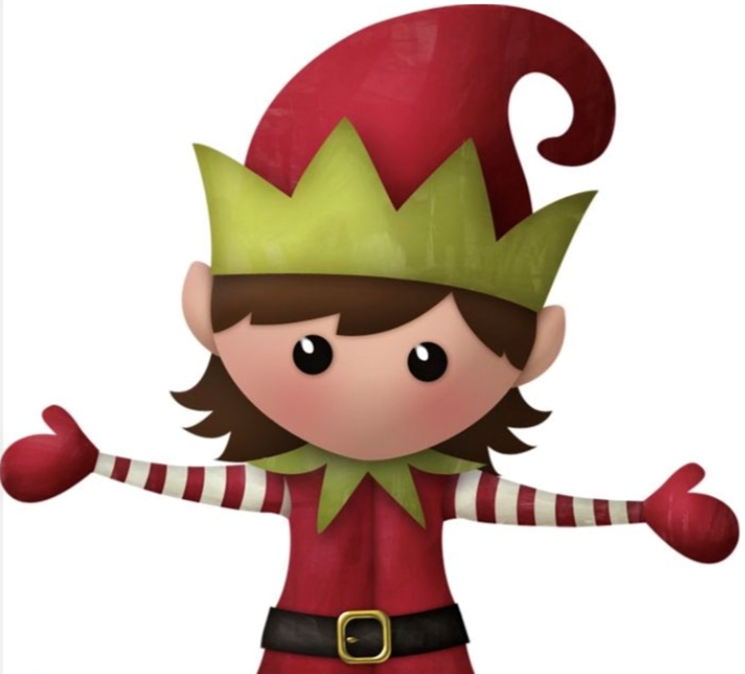

Upcoming Events
Friday 7th November, from 5.30pm
West Byfleet Junior School Firework Tickets are now available. Get yours here: https://new-haw-junior-school-pta.sumupstore.com/
Friday 14th November,Christmas Quiz from 7pm
Our first quiz of the year is here! Getting you in the festive spirit! Get your teams together and join us for a great night and some food! More details to follow!
Saturday 22nd November, 2 – 6pm
Broadway Lights Switch-on: We will be running a cake stall and novelty tombola at this year’s light-switch on.
Volunteers and cake donations needed
Thursday 4th December, 4.30pm – 6.30pm
Christmas Fayre: Join us for an evening of festive fun at the school. Support the Year 6 Junior Apprentice stalls, try your luck on the tombola or raffle, or watch the choir with a mince pie.
Volunteers needed
Friday 5th December
An exciting way to spend your INSET day: After last years extremely successful and fun day at Chobham Adventure Farm we have managed to secure the party rooms and mezzanine level for your packed lunches and a full day in the soft play. Not only that but there will be NO price increases. Book your tickets here: https://new-haw-junior-school-pta.sumupstore.com/

Slide 3

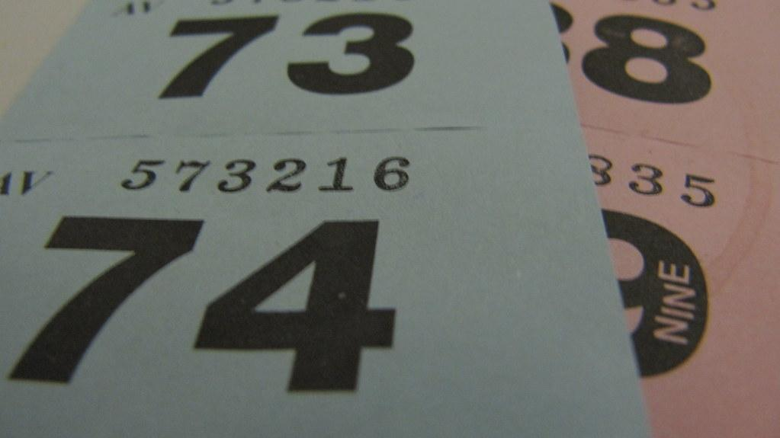
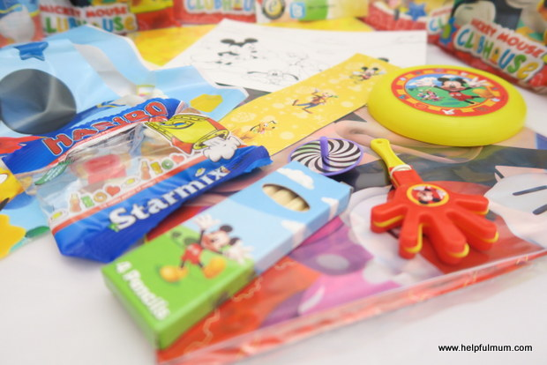


Ways you can help
Be part of the Christmas Fayre
We’re looking for stall holders for our Christmas Fayre on 4th December. If you run a small business and would like a stall then contact us at newhawjuniorpta@gmail.com for more details.
Do you run a business or work for a company that could donate a raffle prize to our Christmas raffle? We would love to hear from you at newhawjuniorpta@gmail.com if you think you could contribute.
Do you have unwanted party bag fillers that you could pass on to us to use as prizes at the Christmas Fayre? If you do then please drop them at Reception.
Help us expand our ‘pre-loved’ stock
We always welcome donations of pre-loved uniform!
If you have any old uniform that your children have outgrown and it is still in a wearable condition please drop to reception where we have a ‘Donations’ bin.
It would be appreciated if all uniform donations could be washed before being dropped off.
Join EasyFundraising
You can sign up to easyfundraising www.easyfundraising.org.uk (search for ‘New Haw Junior School PTA’ under the section ‘Find a cause’) and help raise more funds for the school but doing something as simple as your Christmas shopping!

