Slide 1

Introduction to Supporting Your Child’s Emotional Wellbeing
Helen Robertson and Caroline Blake
Eikon

Slide 2
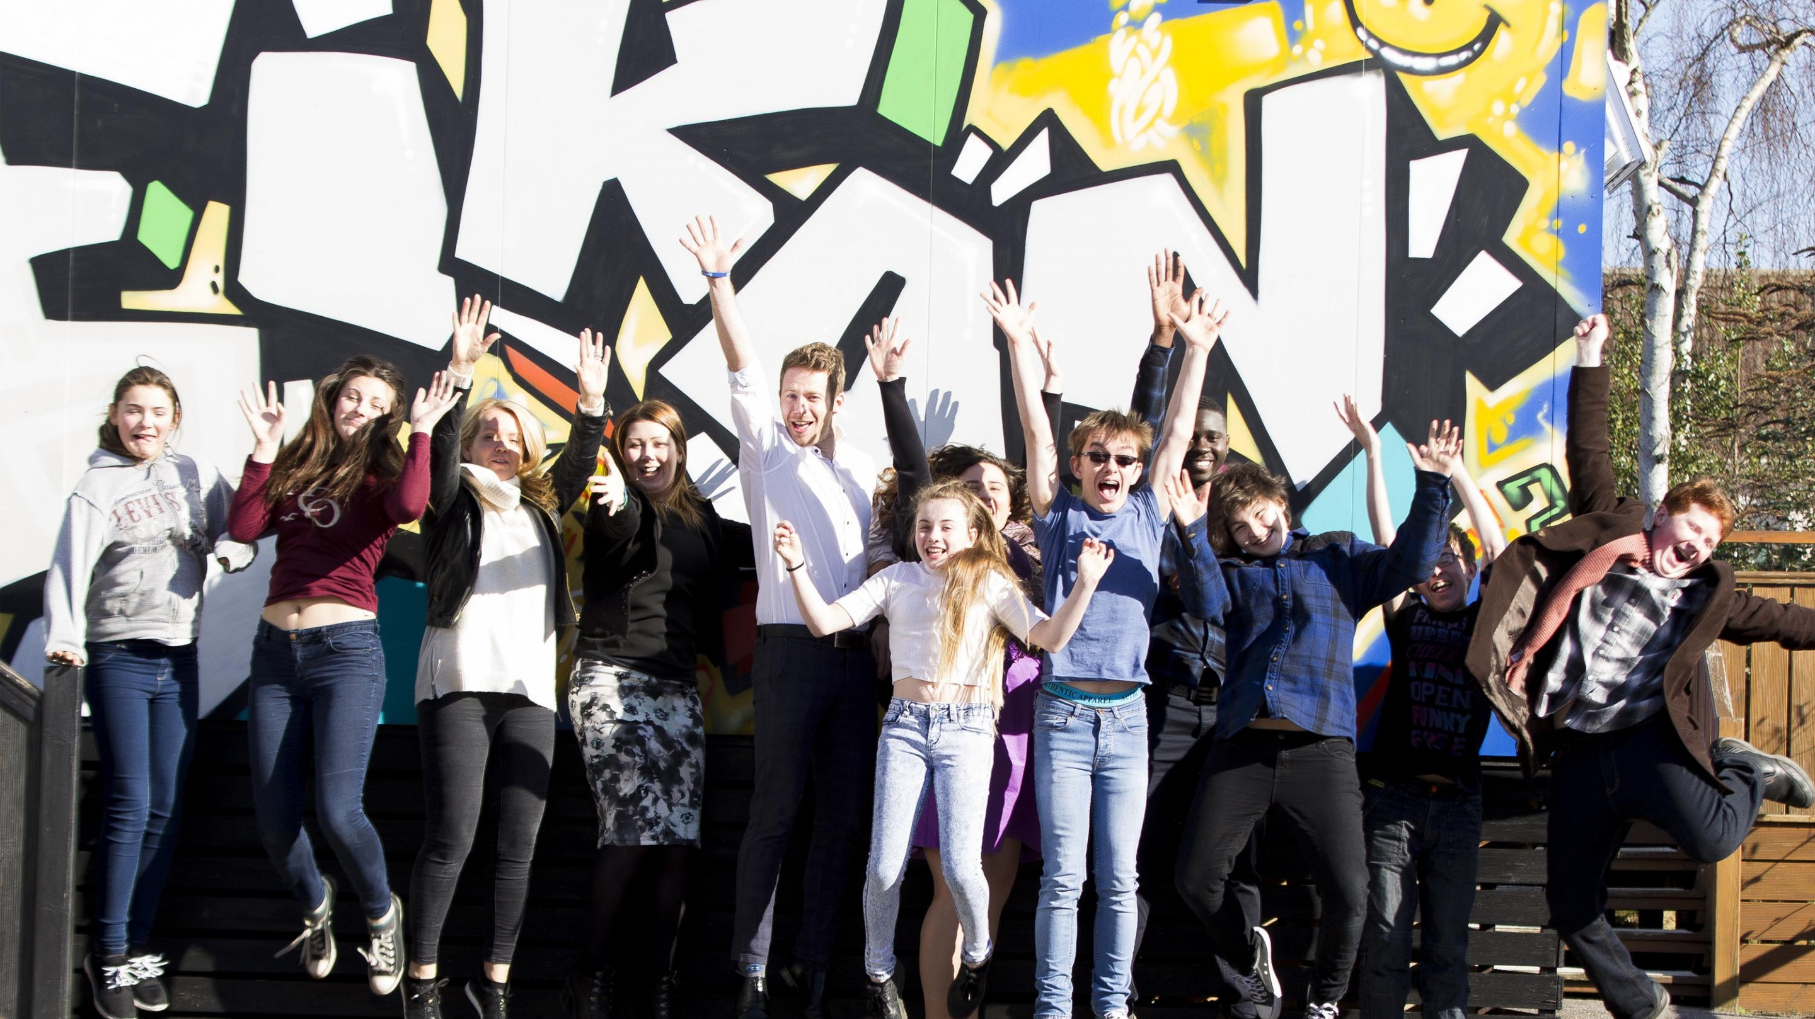

  Counselling and Wellbeing Support
  Community
  Schools

Slide 3
Welcome
Camera and microphone
Questions and chat function – schools@eikon.org.uk
Confidentiality

Slide 4
Aims of The Session
Childhood brain development and the body-brain connection
Explore strategies for positive communication and connection
Explore practical ways to support wellbeing that best suit your child
Learn how to support good sleep routines
Signposting to further support and resources

Slide 5


What is Wellbeing?
From a Young Person’s perspective:
They feel good
Can regulate their emotions
They feel that overall, their life is going well
They can usually cope well with life

Slide 6
Childhood Brain Development
Positive interaction with caregivers in the early years supports healthy brain development
A strong attachment allows children to feel safe to explore the outside world

Slide 7
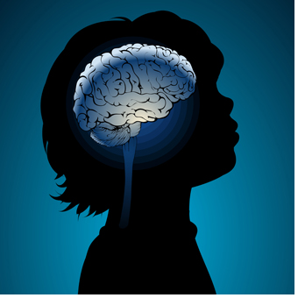
Child Brain Development
Children are born with the survival part on their brain fully functioning.
As their brain develops as does the way in which they can process stimulus, mainly communicated through their emotions.
Care givers help build children to build emotional awareness and communication.

Slide 8

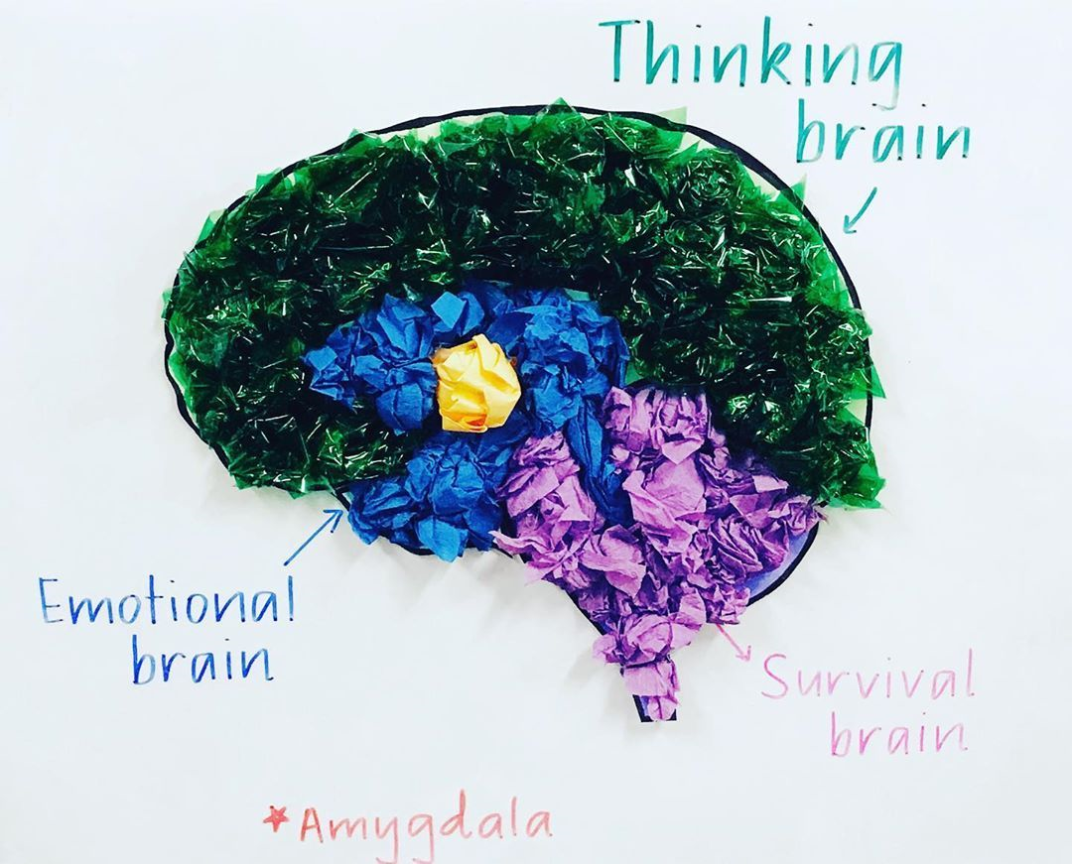
Reasoning, self-control, empathy, resilience, judgment, attention
Big emotions - jealousy, fear, anxiety, anger, frustrations, sadness, loneliness.....
Survival needs, basic bodily functions,

Slide 9
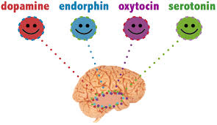
Brain-Body
Connection
Children
Oxytocin: Bonding Chemicals
*Increases feelings of calmness and security.
* Increases creativity.
* Helps with emotional intelligence as increases perception in social situations and empathy.
Boost by: Positive connections, singing to music, free play, hugs.
Dopamine: Feel Good Chemicals
*Children between 6 and 9 have similar levels to adults.
*Childrens dopamine increases through repetition sports i.e. tennis, swimming.
* Screens can increase the level of dopamine making them attractive to children.
Boost by: learn a new skill together, use humour, family goals, focus on what you love about each other.
Serotonin: Calming Chemicals
*Eases tension (caused by dopamine).
*Downtime activities a child enjoys is important to regulate mood and behaviour.
*some artificial sweeteners can reduce serotonin production.
*Regulates sleep.
Boost by: Positive, warm feedback, being given choice and responsibility.
Endorphins: Natural Pain Relief Chemical
*Positive feelings are triggered in the body when we do something we like, music, exercise.
* Increase in physical activity increases ability to learn
*Endorphins stay in the body even after the activity has finished increasing motivation
Boost by: Exercise, creating sense of achievement, laughter, yoga.

Slide 10
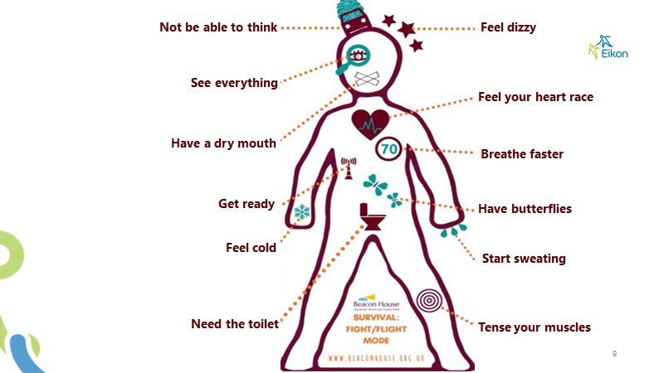

Slide 11

Sleep
The importance of a good night’s sleep for body and brain
The NHS recommends 9-12 hours per night
Routine is essential for regulation and effective sleep

Slide 12
Sleep – Practical Tips
Be aware of how much sleep your child needs
Switch off screens
Regulate eating
The right environment
Create an evening routine
Breathing techniques
Write down worries

Slide 13

Communication and Connection
Active listening
Value their opinion
Find time for the fun stuff
Quality not quantity
Normalise emotions
Model optimism
Encourage their individuality
Focus on what they CAN do

Slide 14

The importance of play
Get creative
Explore their imagination
Go outside
Make it fun
Schedule time to play together
Let them take the lead

Slide 15

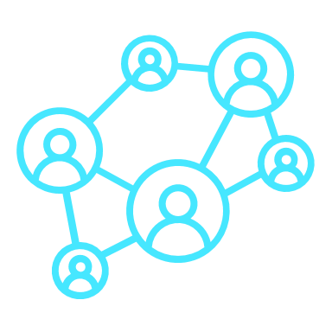



5 Ways
To Wellbeing
Raises aspirations
Support tree
Keep Learning
New Hobbies
Learn a new skill
Board/Card games
Reading
Encourages 'flow'
Beliefs and values
Quality time
Connect
Maintain friendships
Develop new connections
Family time
Write a support list
Increased problem solving
Change environment
Be Active
Walk the dog
School sports
Kick about in the park
Jump on the trampoline
Exercise video
Calms fight flight, freeze
Take Notice
Gratitude
Meditation
Be aware of happiness
Acknowledge achievements
Increases endophines
Aids routine and sleep
Give
Do something nice
Compliment someone
Help a neighbour
Write a note
Filters what is important
Increases connections
Allows an outward focus
Meaning of sensations
Encourages oxytocin release

Slide 16




Resources
www.youngminds.org.uk
Young Minds support children and young people’s mental health. Their website contains a huge amount of information and support for parents, and young people, including support groups and a parents helpline.
www.familylives.org.uk
Family lives has information and support for all areas of parenting, child development and family life, including some excellent advice on behaviour and wellbeing.
www.partnershipforchildren.org.uk
Has some great resources for parents to use with children around understanding emotions
https://www.mindworks-surrey.org/
The new emotional wellbeing and mental health service for children and young people in Surrey.

Slide 17
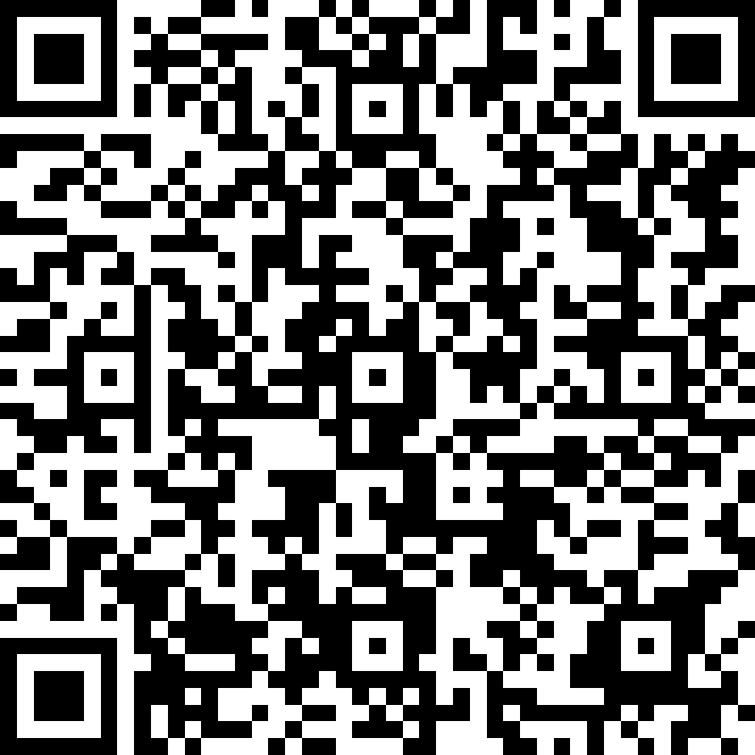
Feedback
Your feedback is really important to us. Without it we can’t access funding to continue our work with other families, schools and young people.
We would be really grateful if you could take 2 minutes to fill out the feedback form.

Slide 18
Thank you!

